Slide 1
BI-DIRECTIONAL GATES
The gates discussed so far (nmos, pmos, rnmos, rpmos, rcmos) are all unidirectional gates
When turned ON, the gate establishes a connection and makes the signal at the input side available at the output side
Verilog has a set of primitives for bi-directional switches as well
They connect the nets on either side when ON and isolate them when OFF. The signal flow can be in either direction
None of the continuous-type assignments at higher levels dealt with so far has a functionality equivalent to the bi-directional gates
There are six types of bidirectional gates

Slide 2
tran and rtran
The tran gate is a bi-directional gate of two ports. When instantiated, it connects the two ports directly
Thus the instantiation tran (s1, s2);
connects the signal lines s1 and s2. Either line can be input, inout or output
rtran is the resistive counterpart of tran

Slide 3
tranif1 and rtranif1
tranif1 is a bi-directional switch turned ON/OFF through a control line
It is in the ON-state when the control signal is at 1 (high) state
When the control line is at state 0 (low), the switch is in the OFF state
A typical instantiation has the form tranif1 (s1, s2, c );
Here c is the control line
If c=1, s1 and s2 are connected and signal transmission can be in either direction
rtranif1 is the resistive counterpart of tranif1. It is instantiated in an identical manner

Slide 4
tranif0 and rtranif0
tranif0 and rtranif0 are again bi-directional switches
The switch is OFF if the control line is in the 1 (high) state, and it is ON when the control line is in the 0 (low) state
A typical instantiation has the form tranif0 (s1, s2, c);
With the above instantiation, if c = 0, s1 and s2 are connected and signal transmission can be in either direction. If c = 1, the switch is OFF and s1 and s2 are isolated from each other
rtranif0 is the resistive counterpart of tranif0

Slide 5
OBSERVATIONS:
Any instantiation of a bi-directional switch of the above types can be given a name. But a name is not essential. It is true of the other switches also.
With the bi-directional switches the signal on either side can be of input, output, or inout type. They can be nets or appearing as ports in the module. But the type declaration on the two sides has to be consistent.
The connections to the bi-directional terminals of each of the bi-directional switches have to be scalars or individual bits of vectors and not vector themselves.
In the above instantiation s1 can be an input port in a module. In that case, s2 has to be a net forming an input to another instantiated module or circuit block. s2 can be of output or inout type also. But it cannot be another input port.
s1 and s2 – both cannot be output ports.
s1 and s2 – both can be inout ports.
With tran, tranif1, and tranif0 bi-directional switches if the input signal has strength supply1 (supply0), the output side signal has strength strong1 (strong0). For all other strength values of the input signal, the strength value of the output side signal retains the strength of the input side signal.
With rtran, rtranif1 and rtranif0 switches the output side signal strength is less than that of the input side signal. The strength reduction is on the lines shown in Table 10.4 for rnmos, rpmos, and rcmos switches.

Slide 6
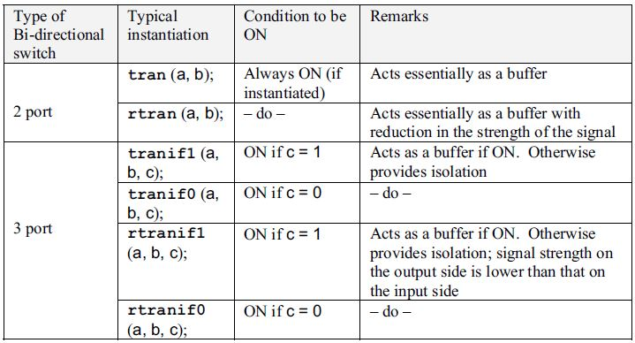
DIFFERENT BI-DIRECTIONAL SWITCHES AND THEIR FEATURES

